Slide 1

Mayureshwar Chavan
Lending Club Case Study

Slide 2
Table of Contents
Problem Statement............................................................................................................................... 3
Analysis approach................................................................................................................................. 3
Analyzing given data..................................................................................................................... 3
Data cleaning................................................................................................................................ 3
Removing columns with all null values................................................................................. 3
Remove columns with same values...................................................................................... 5
Remove columns with same values...................................................................................... 5
Below columns were removed as they had more than 50% of data missing........................5
Remove data not required.................................................................................................... 6
Data type correction............................................................................................................. 6
Removing Outliers.................................................................................................................7
Analyze data after cleaning...........................................................................................................7
Analyze results...................................................................................................................................... 8
Univariate analysis........................................................................................................................ 8
Categorical – Unordered....................................................................................................... 8
Categorical – Ordered......................................................................................................... 10
Quantitative........................................................................................................................ 11
Bivariate analysis........................................................................................................................ 12
Loan status and Annual income.......................................................................................... 12
Loan status and Loan amount.............................................................................................12
Loan status and Purpose.....................................................................................................13
Loan purpose and State...................................................................................................... 13
Derived Metrics.......................................................................................................................... 14
Business Driven Metrics......................................................................................................14
Data Driven Metrics............................................................................................................ 15
Type Driven Metrics............................................................................................................ 15
Conclusion.......................................................................................................................................... 16

Slide 3
Problem Statement
The project revolves around a consumer ﬁnance company specializing in lending various types of loans to urban customers. The company receives loan applications and makes decisions based on the applicant’s proﬁle. The project aims to use exploratory data analysis (EDA) to understand the inﬂuence of consumer attributes and loan attributes on the likelihood of loan default.
Analysis approach
The analysis approach includes below steps
Analyzing given data
Below points are observed while analyzing data
Shape and size of matrix
Row count Column count
- 39717
- 111
Columns with null value
Columns with incorrect data type
Understanding different attributes with the help of Dictionary provided along with the data
Data cleaning
Below steps were taken for data cleaning
Removing columns with all null values
Below 54 columns were removed as part of it
S. No | Column names
1 | mths_since_last_major_derog
2 | annual_inc_joint
3 | dti_joint
4 | verification_status_joint
5 | tot_coll_amt
6 | tot_cur_bal
7 | open_acc_6m
8 | open_il_6m

Slide 4
9 | open_il_12m
10 | open_il_24m
11 | mths_since_rcnt_il
12 | total_bal_il
13 | il_util
14 | open_rv_12m
15 | open_rv_24m
16 | max_bal_bc
17 | all_util
18 | total_rev_hi_lim
19 | inq_fi
20 | total_cu_tl
21 | inq_last_12m
22 | acc_open_past_24mths
23 | avg_cur_bal
24 | bc_open_to_buy
25 | bc_util
26 | mo_sin_old_il_acct
27 | mo_sin_old_rev_tl_op
28 | mo_sin_rcnt_rev_tl_op
29 | mo_sin_rcnt_tl
30 | mort_acc
31 | mths_since_recent_bc
32 | mths_since_recent_bc_dlq
33 | mths_since_recent_inq
34 | mths_since_recent_revol_delinq
35 | num_accts_ever_120_pd
36 | num_actv_bc_tl
37 | num_actv_rev_tl
38 | num_bc_sats
39 | um_bc_tl
40 | num_il_tl
41 | num_op_rev_tl
42 | num_rev_accts
43 | num_rev_tl_bal_gt_0
44 | num_sats
45 | num_tl_120dpd_2m
46 | num_tl_30dpd
47 | num_tl_90g_dpd_24m
48 | num_tl_op_past_12m
49 | pct_tl_nvr_dlq
50 | percent_bc_gt_75
51 | tot_hi_cred_lim
52 | total_bal_ex_mort
53 | total_bc_limit

Slide 5
54
total_il_high_credit_limit
2.2.2. Remove columns with same values
S No | Column Name | Value
1 | application_type | INDIVIDUAL
2 | collections_12_mths_ex_med | 0.0
3 | policy_code | 1
4 | acc_now_delinq | 0
5 | chargeoff_within_12_mths | 0.0
6 | delinq_amnt | 0
7 | tax_liens | 0
8 | pymnt_plan | n
9 | initial_list_status | f
2.2.3. Remove columns with same values
S. No. | Column Name | Reason
1 | desc | It had various different values, which could be categorized into categorical value
2 | url | It is unique and could not be used for group by
3 | Id | It is unique and could not be used for group by
4 | Member_id | It is unique and could not be used for group by
5 | title | Purpose column has details and is better for aggregation

Slide 6
6 | Zip_code | It has only first three digits of zip-code.
2.2.4. Below columns were removed as they had more than 50% of data missing
S. No. | Column Name
1 | last_credit_pull_d
2 | pub_rec_bankruptcies
3 | emp_length
4 | last_pymnt_amnt
5 | revol_util
6 | emp_title
7 | last_pymnt_d
2.2.5. Remove data not required
S. No. | Loan_status | Reason
1 | Current | The loan is in progress, hence not useful to find defaulter traits And it contributes to only 3% of the total data
2.2.6. Data type correction
S. No. | Column Name | Reason

Slide 7
1 | term | Remove the string month from column values, and change it to INT data type
2 | int_rate | Remove % from column values, and change it to float data type
3 | revol_util | Remove % from column values, and change it to float data type
4 | emp_length | Remove experience, >, < from column values, and change it to float data type
5 | funded_amnt_in v | Standardize precision. Four decimal point converted to two
2.2.7. Removing Outliers
S. No. | Column Name | Reason
1 | annual_inc | Value more than Q3 + 1.5*IQR And Value less than Q1 - 1.5*IQR Is removed
Analyze data after cleaning
Once the data is cleaned by following the above steps, it is analyzed using below steps:-
Univariate analysis
Bivariate analysis
Derived matrix
The result of this analysis is elaborated in next section – Analyze results

Slide 8
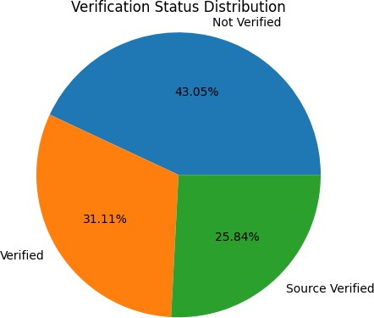
Analyze results
Univariate analysis
Categorical – Unordered
Verification status
Majority of the loans are Not Verified
3.1.1.2.Loan status
Around 14.13% of loan are in Charged Off state

Slide 9
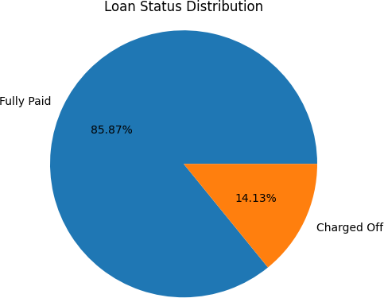
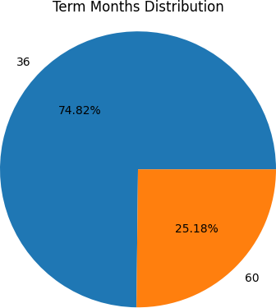
3.1.1.3.Term period
Around 75% of people take loan for a period of 36 months
3.1.1.4.Purpose of Loan
Around 50% of the people take loan for Debt consolidation
Purpose | Percentag e
debt_consolidation | 48.18
credit_card | 13.07
other | 9.84

Slide 10
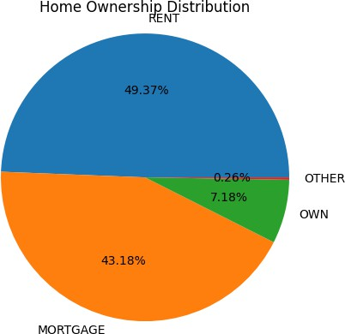
home_improvemen t | 6.98
major_purchase | 5.59
car | 4.02
small_business | 3.74
wedding | 2.48
medical | 1.74
moving | 1.48
vacation | 0.95
house | 0.91
educational | 0.79
renewable_energy | 0.24
3.1.1.5.Home Ownership
Majority of the people who take loan do not own a house
Categorical – Ordered
Issue date
The numbers of loans have increased with time

Slide 11
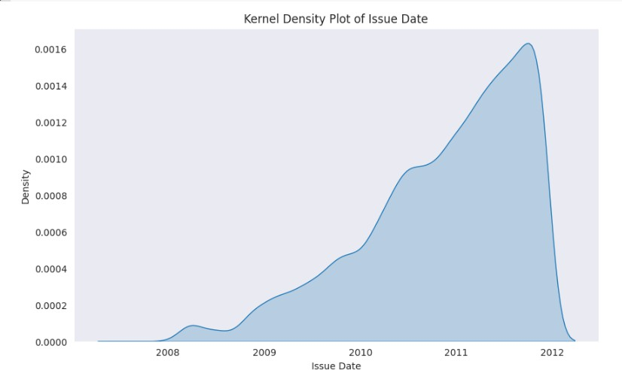
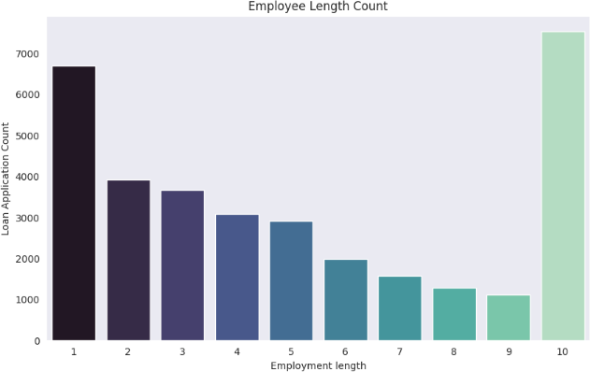
3.1.2.2.Employee length
Majority of the loan is taken by people with less than 1 year of experience or more than 10 years of experience.

Slide 12
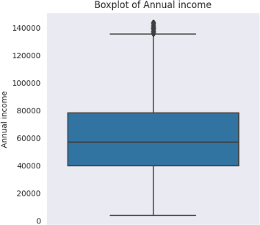
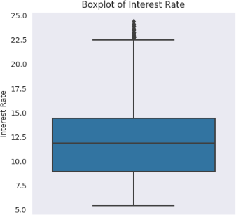
Quantitative
Annual income
Majority of the people’s annual income lies between 40000 and 80000.
3.1.3.2.Interest Rate
Majority of people have interest rate in between 9% and 14.5%

Slide 13
Bivariate analysis
Loan status and Annual income
Salary is inversely proportional to Charge off. With decrease in salary, charge off possibility increases.
Annual Income | Charged Off | Fully Paid | Charged Off percentage
0-20000 | 162 | 716 | 18.45
20000-40000 | 1305 | 6308 | 17.14
40000-60000 | 1555 | 8902 | 14.87
60000-80000 | 918 | 6246 | 12.81
80000 + | 831 | 6813 | 10.87
3.2.2. Loan status and Loan amount
Loan amount is directly proportional to Charge off possibility. Especially, for loan of more than 28000.
Loan amount | Charged Off | Fully Paid | Charged Off percentage
0-5000 | 1084 | 7228 | 13.04
5000-10000 | 1414 | 10025 | 12.36
10000-20000 | 1588 | 9111 | 14.84
20000-30000 | 543 | 2254 | 19.41
30000-40000 + | 142 | 367 | 27.9
3.2.3. Loan status and Purpose
Loan for the purpose of small business has more chances of Charge Off.

Slide 14
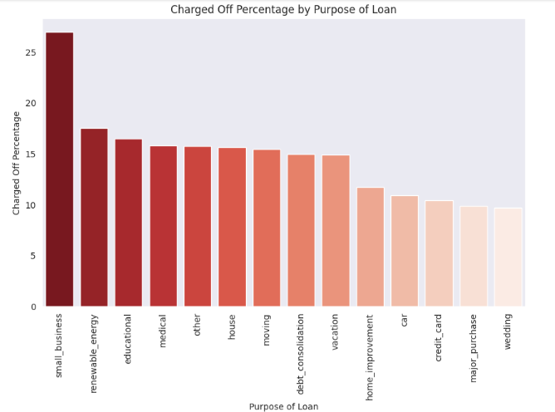
3.2.4. Loan purpose and State
The percentage of 'Debt Consolidation' loans does not vary significantly across states. However, states such as 'TN,' 'AK,' 'MT,' and 'MS' have a higher percentage of 'Small Business' loans. This chart can help make informed decisions by identifying states with a higher proportion of charged-off loans.

Slide 15
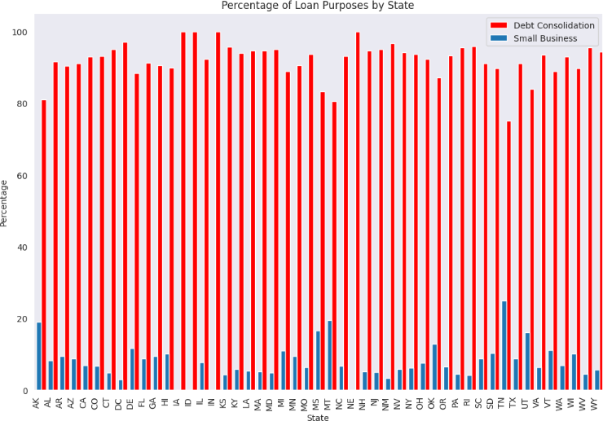
Derived Metrics
Business Driven Metrics
Debt to income ratio
Debt to income ratio is calculated by dividing installment by month salary (month salary derived from annual salary divided by 12)
On calculating Debt to Income ratio it is observed that the chances of Charged Off increases with increase in ratio. However, it is not a clear increase, as there is decrease for 0.2+ debt to income ratio.
Debt-income-ratio | Charged Off | Fully Paid | Charged Off percentage
0-0.04 | 1126 | 8640 | 11.53
0.04-0.08 | 1711 | 11570 | 12.88
0.08-0.12 | 1222 | 5880 | 17.21
0.12-0.16 | 529 | 2218 | 19.26
0.16-0.2 | 154 | 554 | 21.75

Slide 16
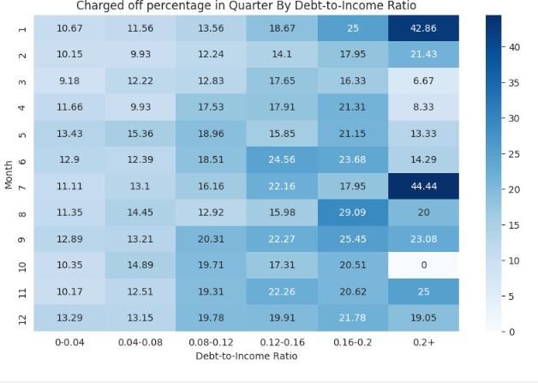
0.2+ | 29 | 123 | 19.08
Data Driven Metrics
Charged Off
Created a column to indicate charged off (value 0 for False, 1 for True) from column loan_status. It was used to create the graph below.
As per below graph, around close to 40% of Charged Off happen in month of January and July having maximum Debt to Income ratio (0.2+)
Type Driven Metrics
Month
Month is derived from issue date.
This data is used to derive conclusions in the previous section.

Slide 17
Conclusion
Below are the key conclusions to determine the Charged Off cases:-
Charged Off possibility increases with increase in loan amount. Around 25% for loans more than 28000.
Charged Off possibility increases with decrease in annual income.
Close to 40% of Charged Off happen in the months of January and July having maximum Debt to Income ratio (0.2+). It could be due to the Festive season in December and Summer vacation in May-June.
Majority of the loans are taken for the purpose of Debt Consolidation and it is 8th highest in terms of Charged of percentage.
Chances of Debt are observed to be more when loan taken for Small business, especially in states such as TN, AK, MT and MS.

